Slide 1

PYTHON FULL STACK DEVELOPMENT TOPIC:HTML CODE GENERATOR TOOL
By
B. Akshaya(2110030345)
U. Yesashwini(2110030412)
P. Subhatish(2110030426)
K. Dhana Sree(2110030444)
Under the guidance of
(Ms. Madhu Priya)

Slide 2
1.PROBLEM STATEMENT AND DOMAIN
We are creating a web application for university registration as part of our project.
Manual registration is tedious and takes a lot of time and labor.
In Online, we can access it from anywhere, doesn't require human labor or assistance from others.
By managing the data with correct authentication, we can reduce the workload of all those manually involved and lessen the effort.

Slide 3
2.DOCUMENTATION (LITERATURE REVIEW)
https://www.academia.edu/3410337/Challenges_of_Students_Online_Registration_System
https://www.ijert.org/research/an-implimentation-of-an-online-based-registration-system-in-tertiary-institutions-in-zimbabwe-IJERTV2IS100988.pdf

Slide 4
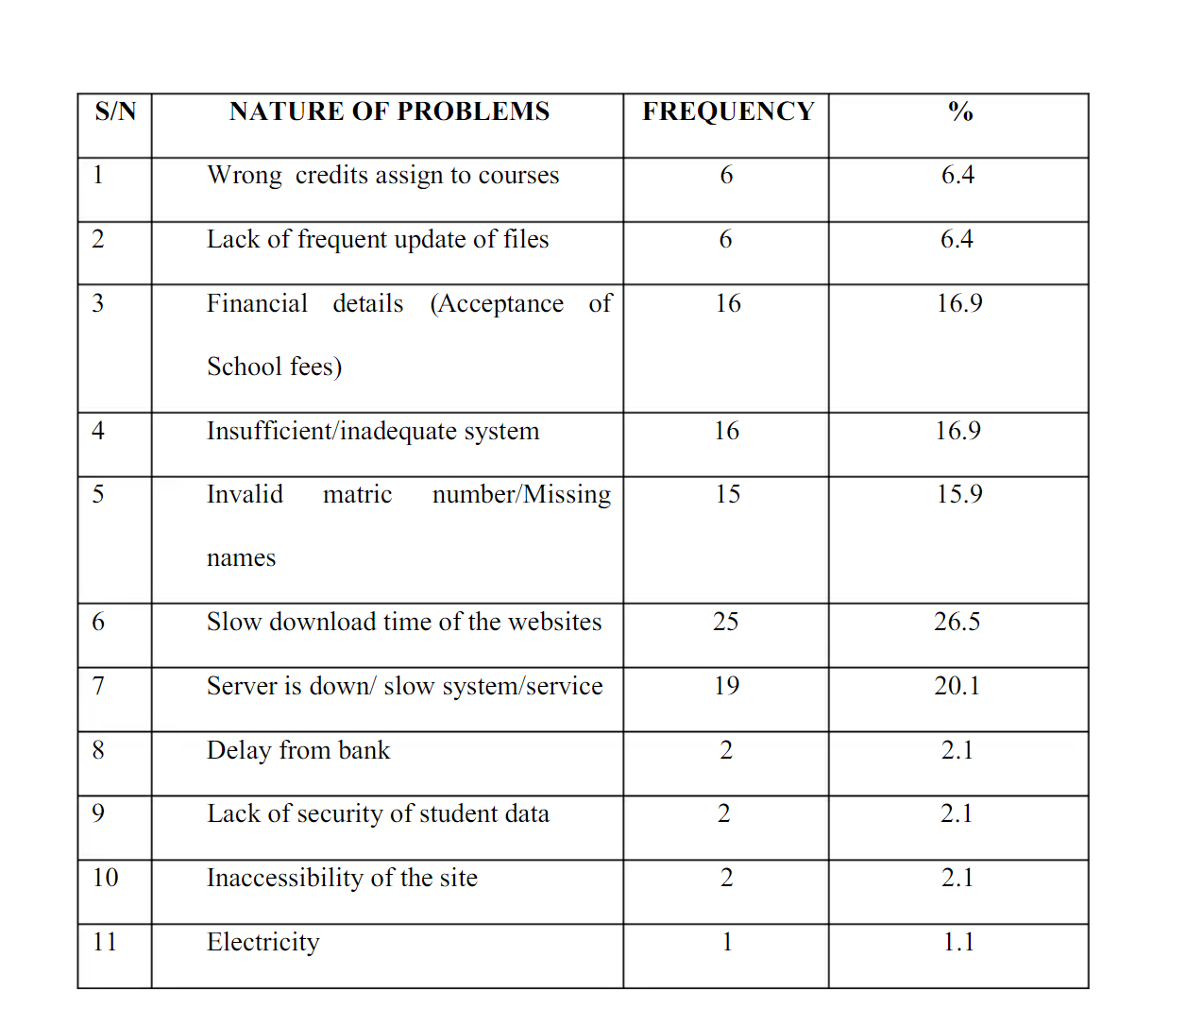
DOCUMENTATION (LITERATURE REVIEW)
Statistics of issues faced in many universities
Network glitch.
Students face many issues while accessing that are to be resolved.

Slide 5
3.EXISTING SOLUTIONS
LMS
ERP
OFFLINE REGISTRATION

Slide 6
4.OUR OBJECTIVE
To identify the challenges of the online course registration system.
To review and evaluate the online registration website.
Check whether the issues are cleared through our web application or not.

Slide 7
5.ADDITIONAL FEATURES IN OUR WEB APPLICATION
Offer opportunities to provide feedback.
Add a questionnaire forum to rectify doubts regarding registration.
An instructor/mentor to respond to your doubts.

Slide 8
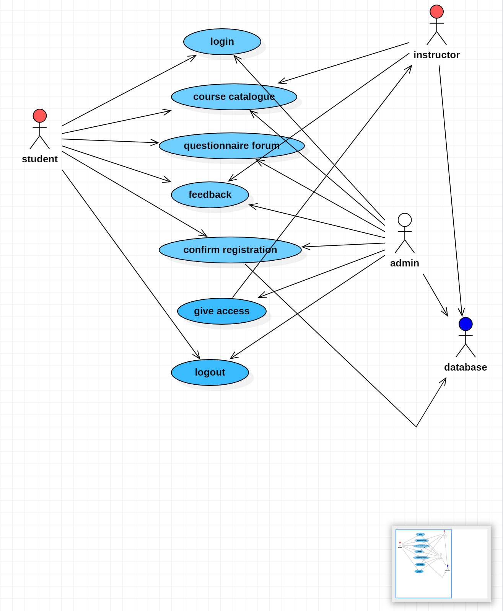
6.USE CASE DIAGRAM

Slide 9
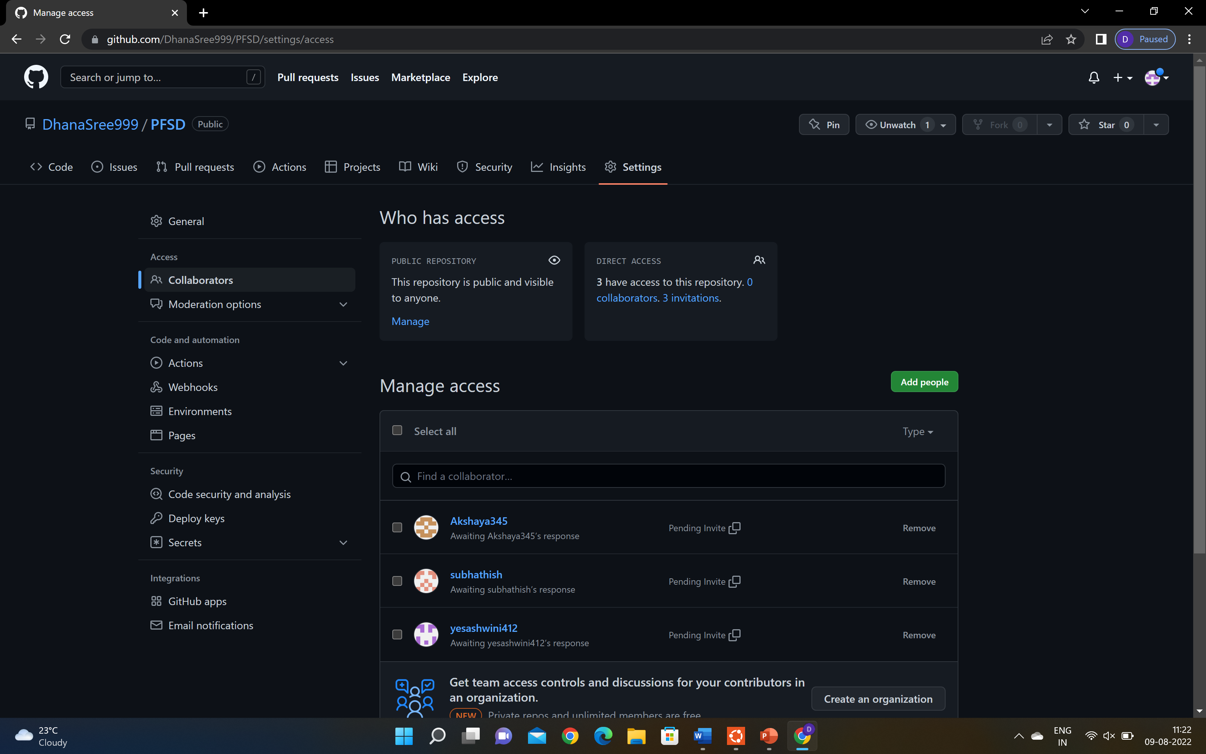
7.GITHUB SETUP
https://github.com/DhanaSree999/PFSD/settings/access

Slide 10
GITHUB SETUP
https://github.com/Akshaya345/PFSD
https://github.com/yesashwini412/PFSD
https://github.com/subhathish/PFSD
https://github.com/DhanaSree999/PFSD

Slide 11
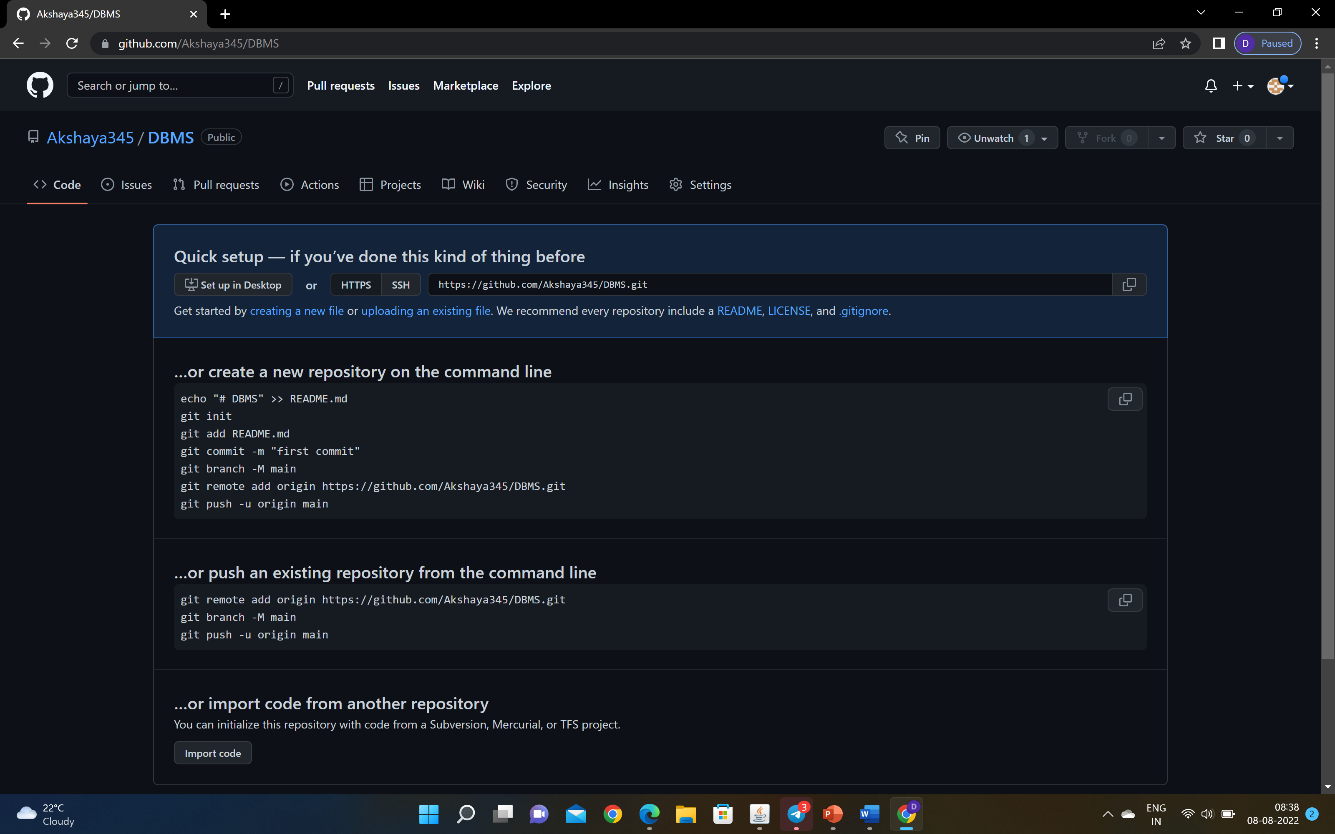
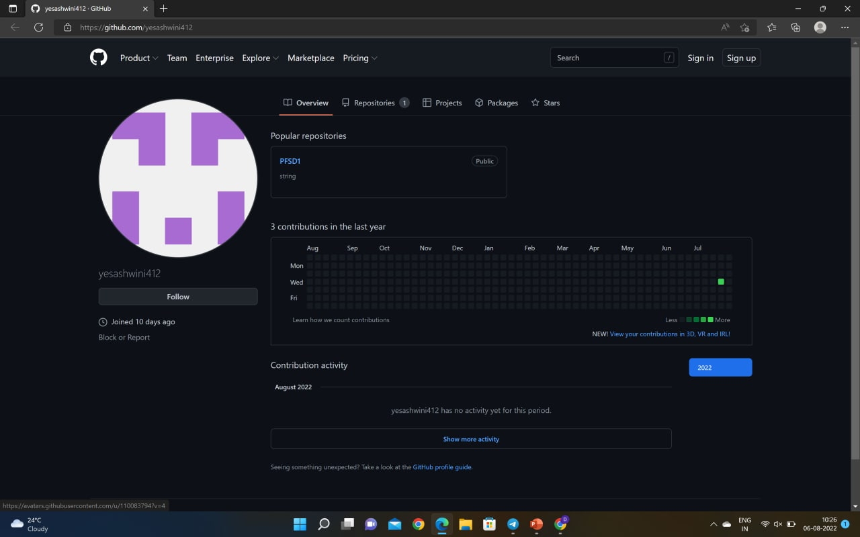
Github setup

Slide 12
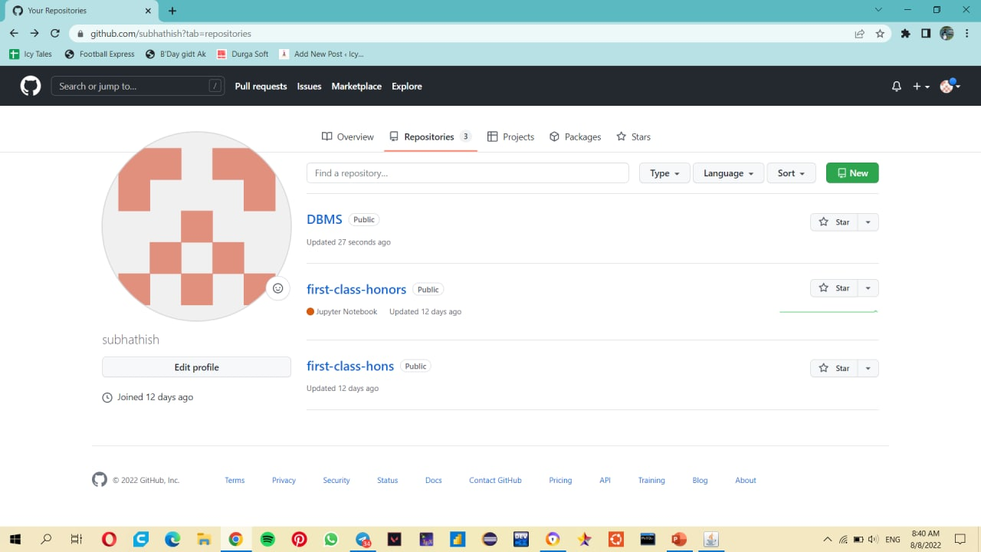
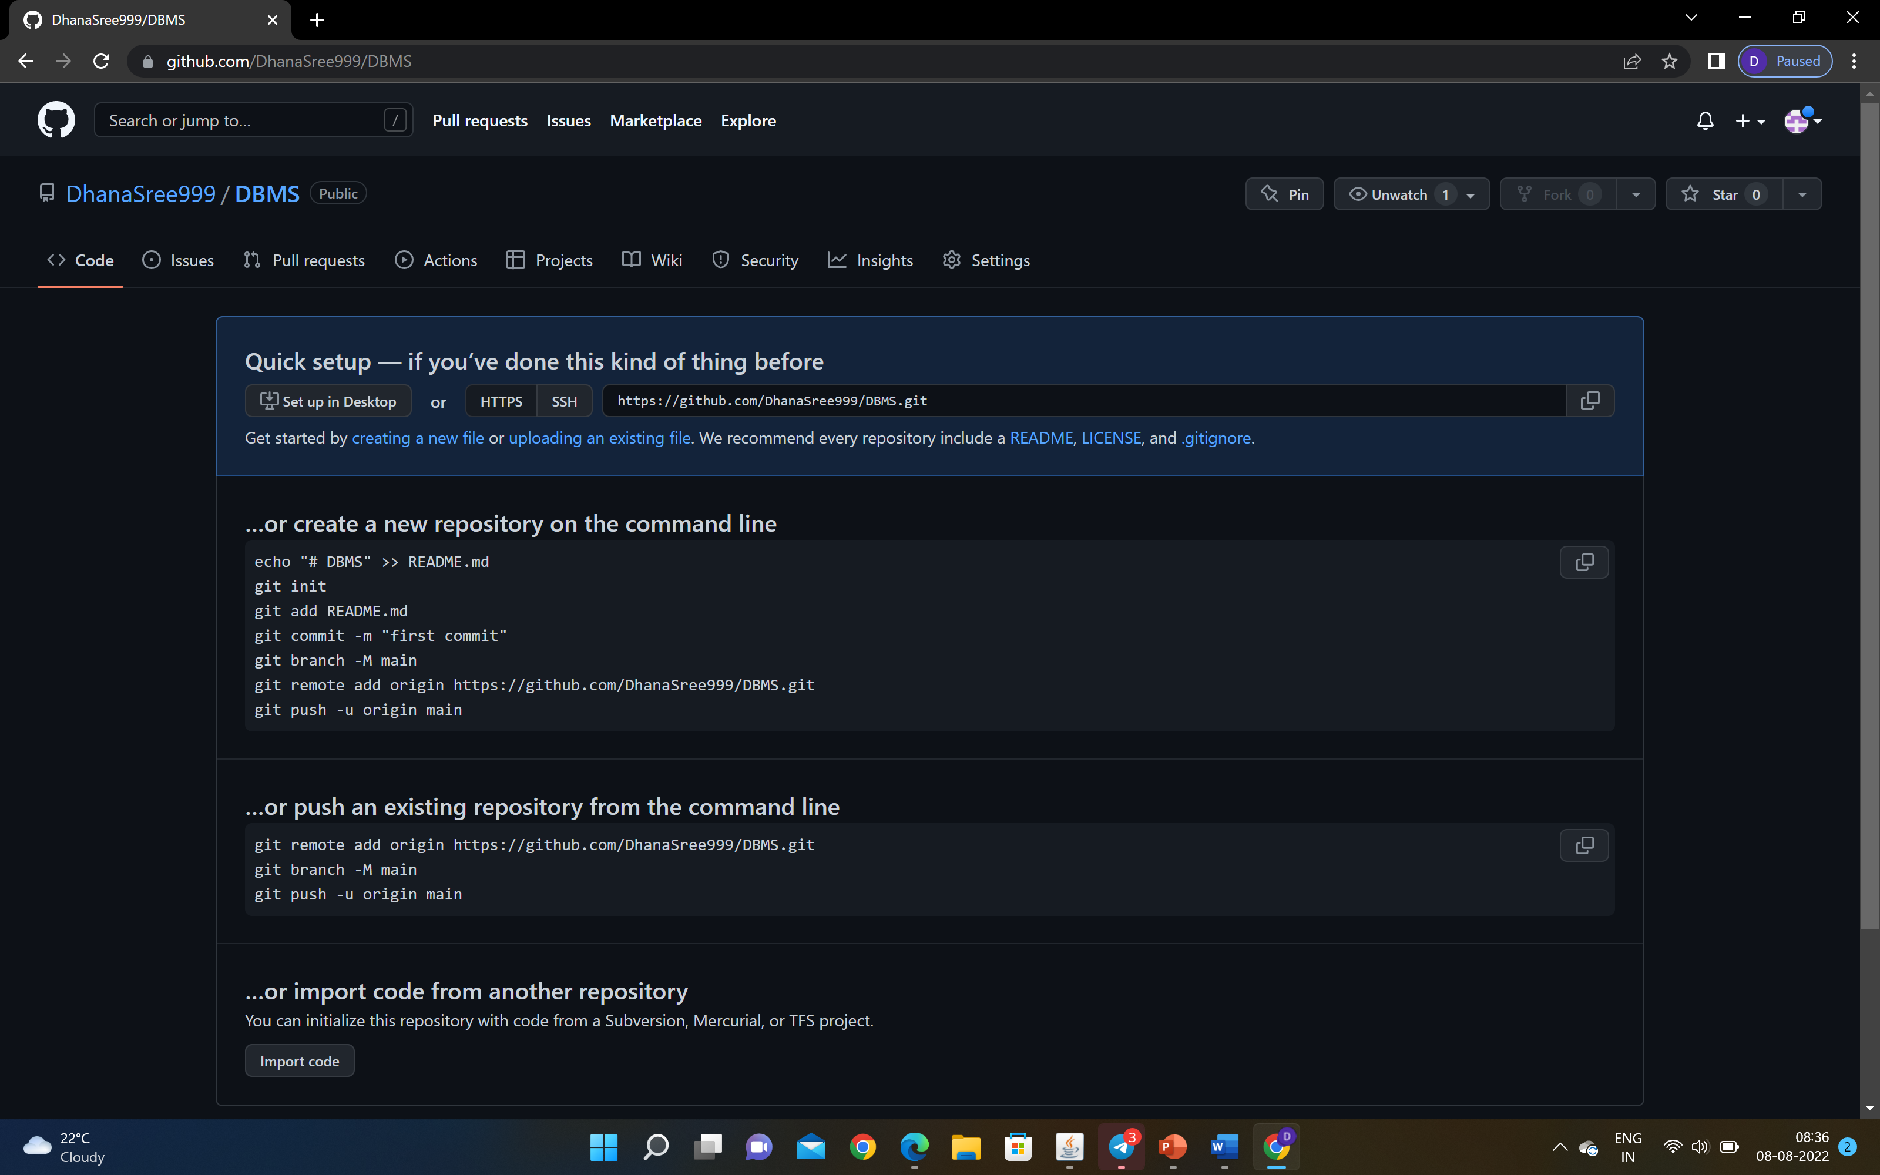

Slide 13
8.TOOLS SETUP
Django
Django is a high-level Python web framework that enables development of secure and maintainable websites.
MySQL
MySQL is a database management system.
MySQL is ideal for storing application data in multiple tables, specifically web application data.

Slide 14
9.WORK ALLOCATION TO TEAM MEMBERS
S.NO | ROLL NO | NAME | DIVISION OF WORK
1 | 2110030345 | B.AKSHAYA | Communication, Software documentation
2 | 2110030412 | U.YESASHWINI | planning, testing
3 | 2110030426 | P.SUBHATHISH | Modeling(front-end), review
4 | 2110030444 | K.DHANA SREE | Development(Back-end), maintenance

Slide 15


